Slide 1

INT-312 Big Data Fundamentals
Unit 1-Introduction To Hadoop

Slide 2
CONTENTS
Introduction/ Definition
Data Sources
V’s of Big Data
Types of Data
Hadoop History
Introduction to Hadoop
Hadoop Components
Hadoop 2.0 Components
Applications of Big Data
Challenges of Big data

Slide 3
Introduction To Big Data
Data too big for traditional tools.
Generated rapidly from many sources.
Complex to process and analyze.
Drives innovation across industries.
Includes structured and unstructured data.
Key enabler for smarter decisions.

Slide 4





Different Sources of Data
Facebook: 10 billion photos stored today.
500 TB data received daily by Facebook.
Twitter(X): 600 million tweets daily shared.
eBay: Generates 500 TB data per day.
YouTube: 300 hours videos uploaded every minute.
WhatsApp: 4.7 billion photos shared daily.

Slide 5
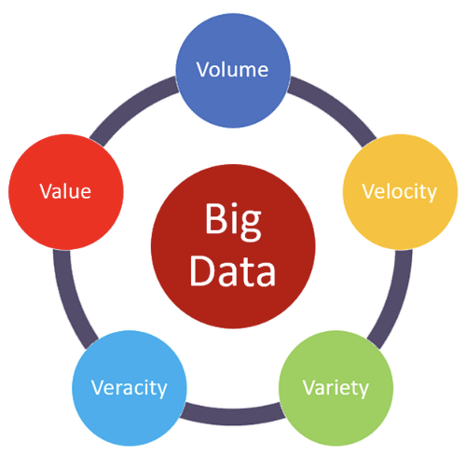
V’s of Big Data
Volume: Data size is massive.
Velocity: Rapid data generation speed.
Variety: Diverse data types and sources.
Veracity: Uncertain or incomplete data.
Value: Extracting insights and meaning.
Vital for modern analytics tools.

Slide 6
Types of Data
Structured: Organised rows and columns.
Unstructured: Free text, images, videos.
Semi-structured: XML, JSON formats.
Machine-generated: Logs, sensor data.
Human-generated: Social media posts.
Hybrid data involves multiple types.

Slide 7
Hadoop History
Based on Google’s pioneering work.
Inspired by GFS paper (2003 release).
MapReduce concept published in 2004.
Introduced a radical distributed computing approach.
Designed for scalability and reliability needs.
Transforms how large-scale data is processed.

Slide 8

Introduction to Hadoop
Hadoop handles massive data volumes.
Developed by Apache Software Foundation.
Open-source, distributed computing framework.
Solves storage and processing challenges.
Enables scalable, fault-tolerant systems.
Used by companies worldwide effectively.

Slide 9
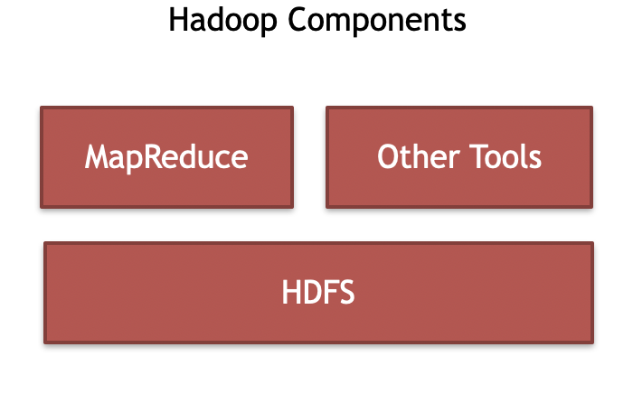
Hadoop Components
HDFS: Distributed file storage system.
MapReduce: Parallel processing framework.

Slide 10
Component of Hadoop 2.0
and its Working
It is released in 2012.
3 main components of Hadoop 2.0 :
HDFS
YARN
MapReduce
Hadoop 2.0 Components
MapReduce
Other tools
YARN
HDFS

Slide 11
Applications of Big Data
Banking: Detects fraud, manages financial risks.
Education: Enables personalised learning systems.
Entertainment: Enhances streaming, content preferences.
E-commerce: Improves recommendations, optimises supply.
Government: Plans policies, improves citizen services.
Healthcare: Advances predictive care, patient monitoring.

Slide 12
Challenges of Big Data
Integration: Combining multiple data sources.
Searching: Retrieving relevant data accurately.
Scalability: Adapting to growing data needs.
Fault tolerance: Ensuring reliable system operations.
Quality: Addressing inconsistent, inaccurate data.
Heterogeneous: Handling diverse data types easily.

Slide 13
THANK YOU

